Slide 1

AiCare
Making Healthcare Infrastructure as Simple as Office 365
Powered by Tachyhealth • Built in KSA 🇸🇦 • Hosted on Humain • Serving the World 🌍

Slide 2

The Global Healthcare Infrastructure Crisis
Existing EMR is a Nightmare
Many Have None
Massive Data Scale
Every hospital CIO/CTO struggles with their current EMR system. Complex implementations, poor user experience, and massive IT overhead create daily frustration for healthcare professionals worldwide.
In many countries, EMR systems don't even exist. Hospitals still rely on paper records and fragmented digital solutions, creating inefficiencies and patient safety risks.
Healthcare data is one of the largest datasets on the planet, encompassing images, videos, reports, and complex medical records that legacy systems can't handle effectively.
Complex, Expensive Implementations
No AI Capabilities Built-in
Requires Massive IT Teams
Traditional EMR deployments require 12-24 months and cost $500K-$5M+
Legacy systems lack modern AI features for clinical decision support and automation
Hospitals need dedicated technical staff just to maintain their EMR systems
Healthcare desperately needs a consumer-grade, AI-powered solution that works out of the box

Slide 3




AiCare: AI-Powered EMR You Can Start Using in Minutes
Subscribe. Select. Start.
As simple as Microsoft Office 365, as powerful as modern AI
Instant Activation
Gazal R1 LLM Powered
No setup, no consultants, no IT projects. Just select modules, enter payment, and start using immediately. Zero deployment time means you can begin improving patient care today.
Advanced AI capabilities powered by Gazal R1 LLM for intelligent automation, clinical decision support, and natural language queries that understand medical context.
Cloud-Native Architecture
Two-Path Migration
Built on Humain's massive AI infrastructure in Saudi Arabia. Scalable, reliable, global reach with 99.99% uptime SLA and enterprise-grade security.
Start fresh with new workflows or seamlessly transition from existing EMR systems with zero downtime. Our AI handles data conversion automatically.

Slide 4
Healthcare: The Best System for AI Consumption
$40B+ Global EMR Market
Growing at 6-7% annually with massive untapped potential in emerging markets
Developed Markets
Emerging Markets
MENA Strategic Focus
Existing EMR users desperate for modern alternative. These markets represent immediate opportunity with hospitals already budgeting for EMR solutions but frustrated with current options.
No EMR infrastructure creates greenfield opportunity. These markets can leapfrog directly to AI-powered solutions without legacy system constraints.
Strategic home market with Saudi backing. Vision 2030 healthcare transformation creates perfect timing for AI-powered EMR adoption.
Government support for digital health
Proven willingness to pay premium prices
Rapid healthcare digitization
Massive healthcare investments
Established procurement processes
Government healthcare initiatives
Regional expansion opportunities
Regulatory frameworks in place
Growing middle class demanding better care
10K+
100K+
6-7%
Hospitals in MENA
Global Hospital Target
Annual Market Growth
Immediate addressable market with strong government support for healthcare digitization
Long-term addressable market across developed and emerging economies
Consistent growth driven by healthcare digitization trends and regulatory requirements

Slide 5
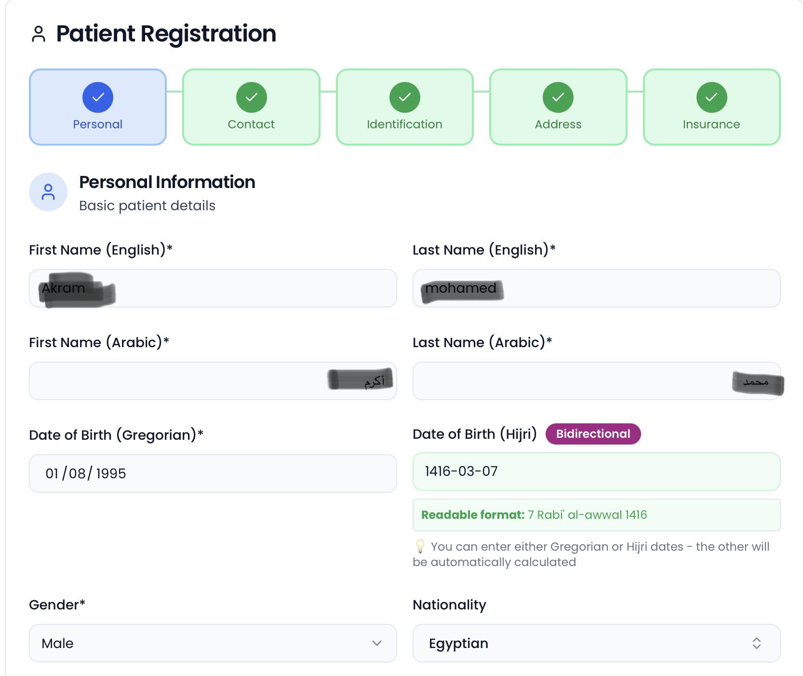
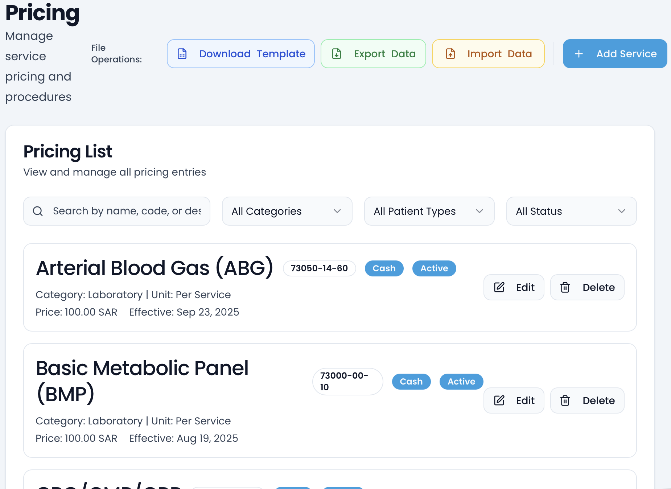
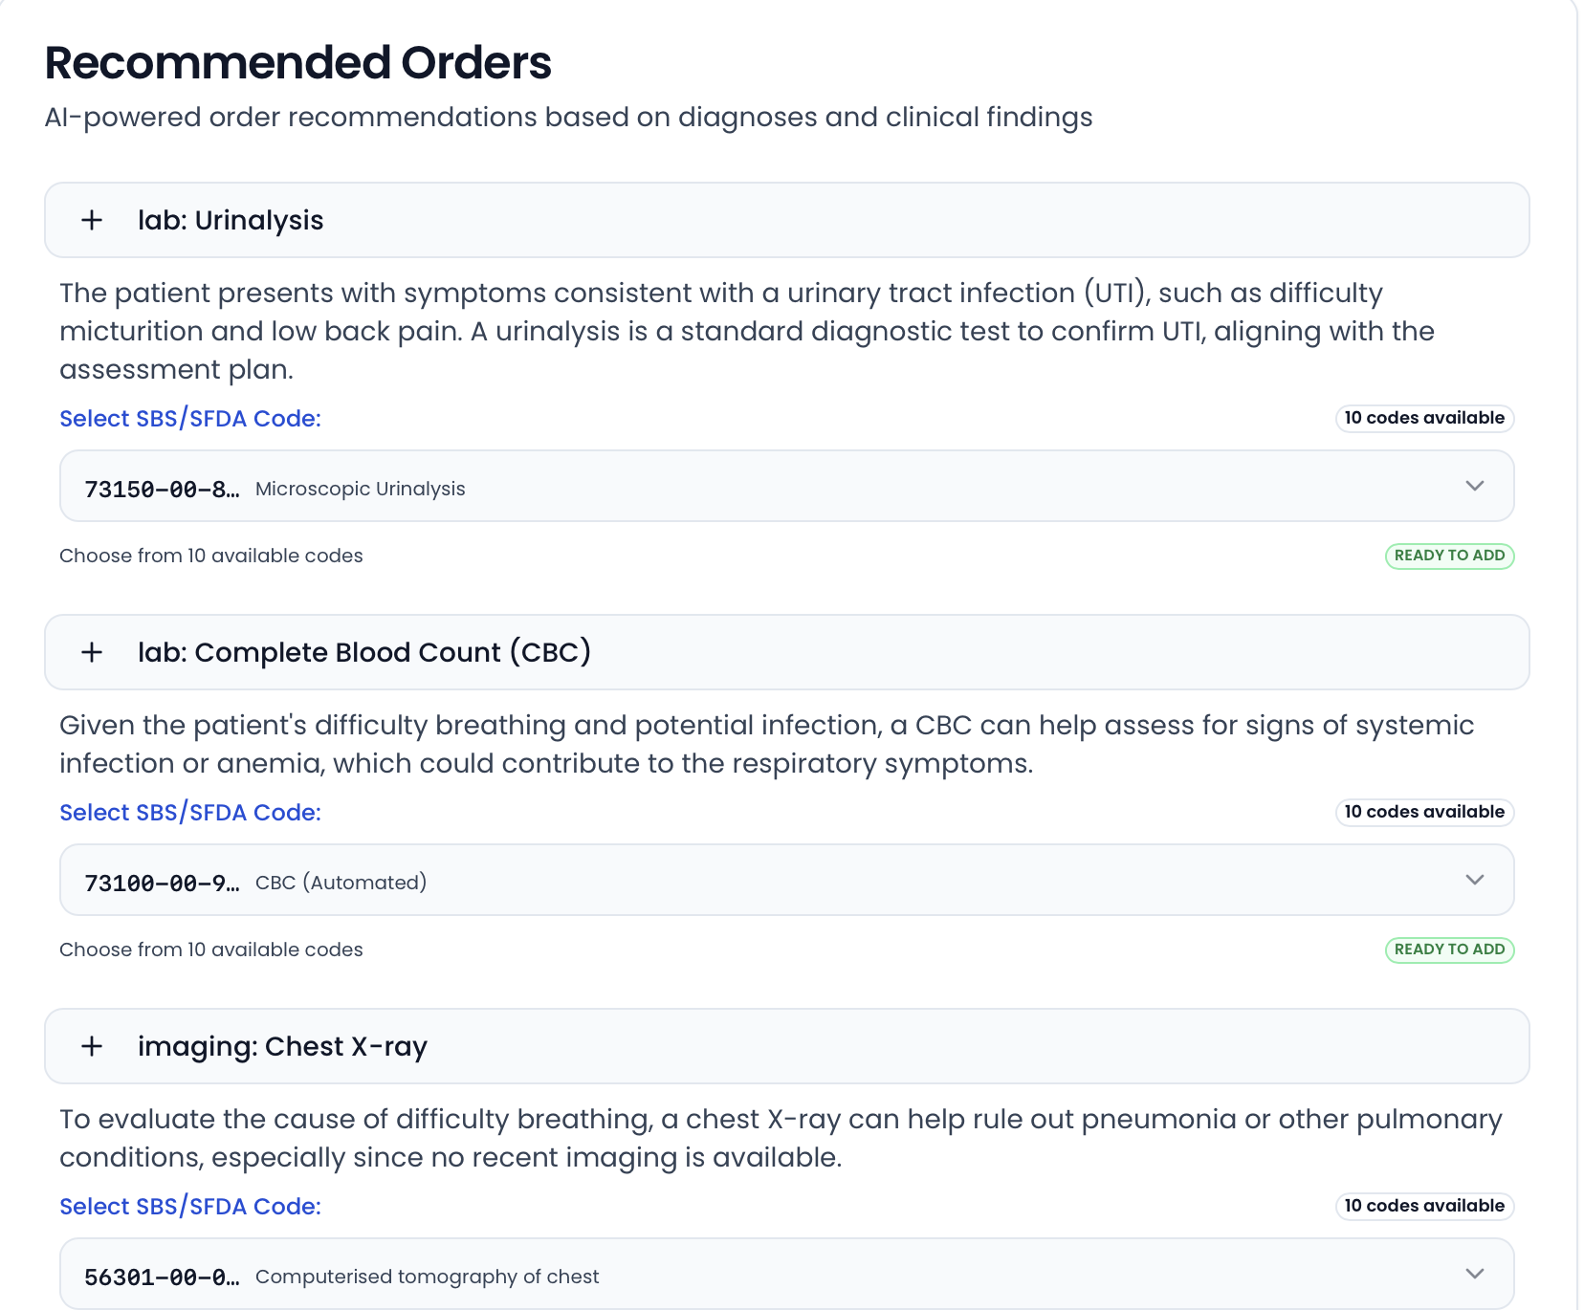
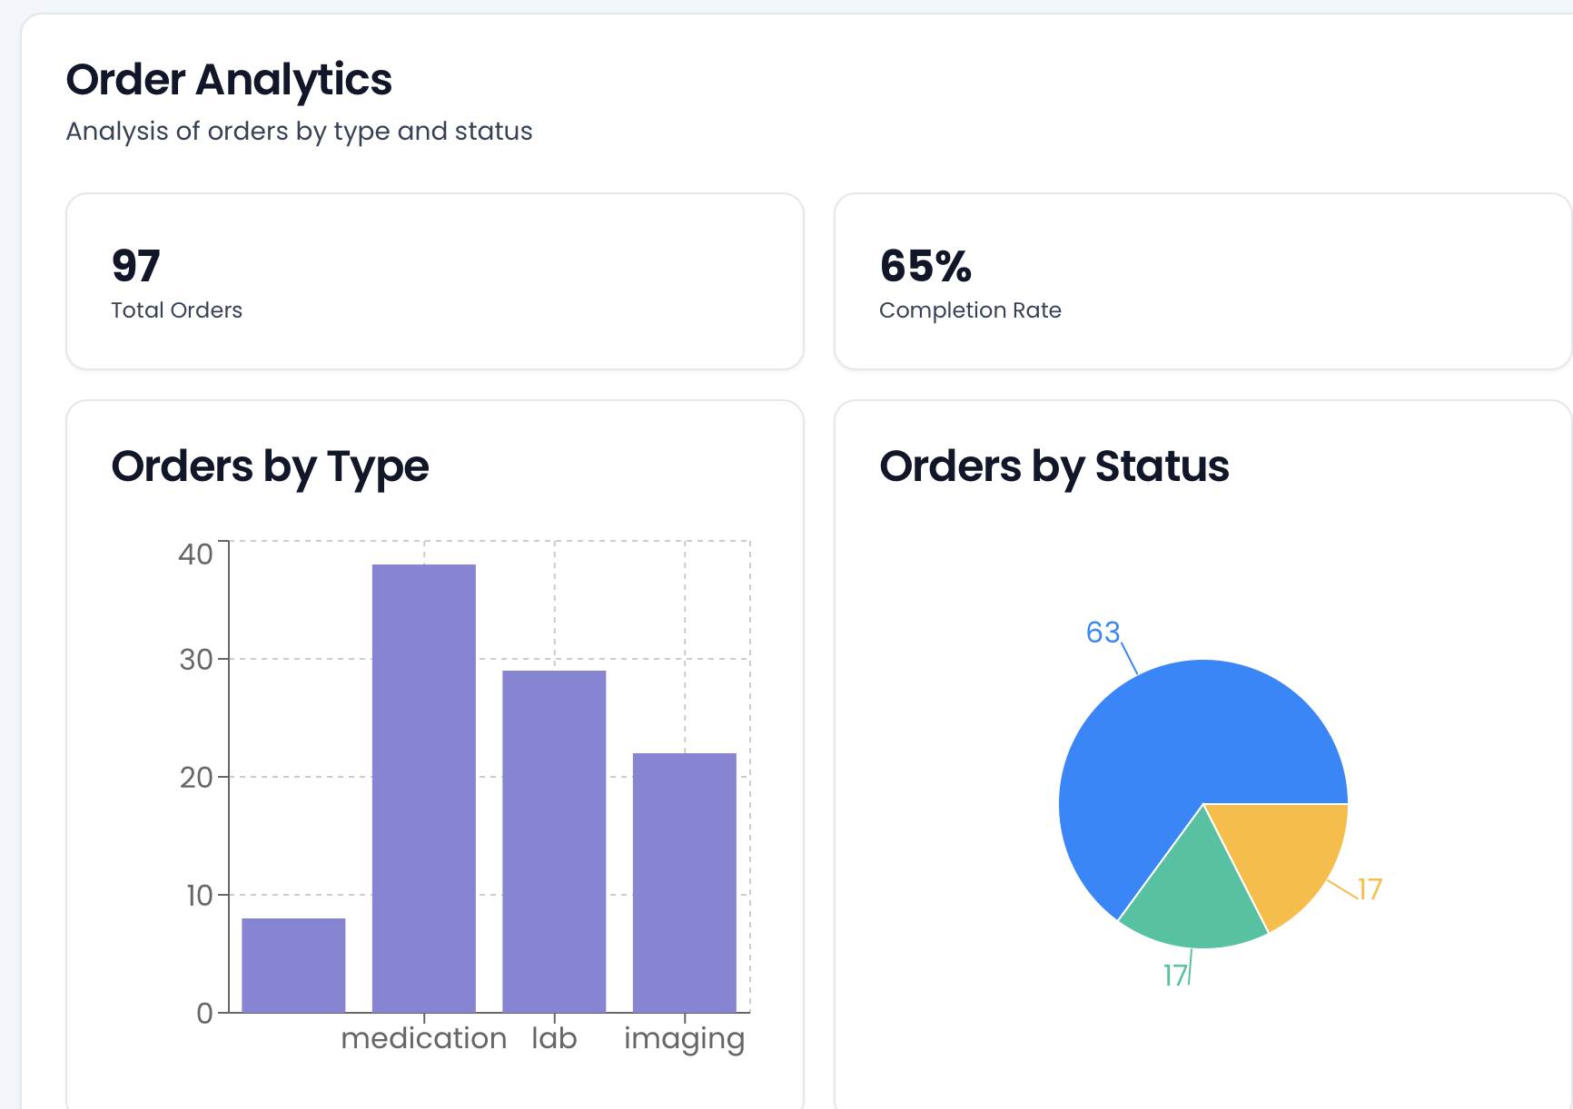
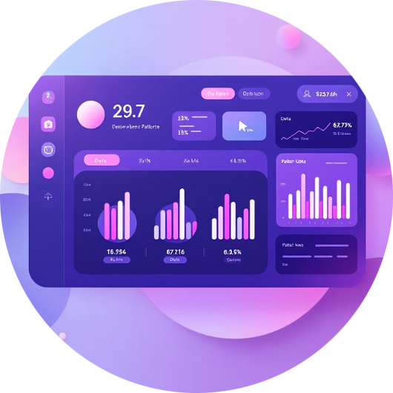
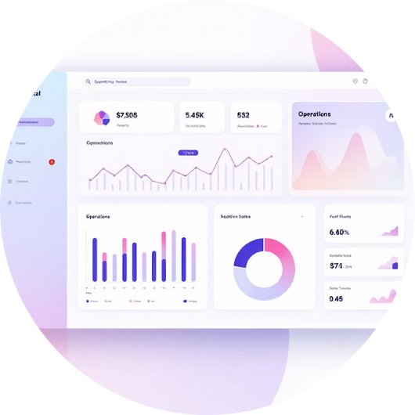

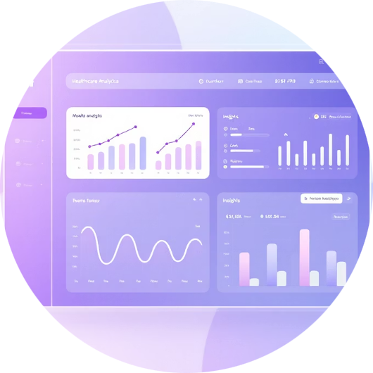
Complete Healthcare Infrastructure Platform
AiCare by Tachyhealth
Complete healthcare infrastructure platform with AI at its core, powered by Gazal R1 LLM
EMR/EHR Core
Hospital Information System
AI Clinical Assistant
Analytics & Insights
Complete patient records supporting all data types including images, videos, reports, and structured medical data with intelligent search and retrieval.
Full HIS operations management including scheduling, billing, inventory, and resource allocation with real-time analytics and reporting.
Powered by Gazal R1 LLM for clinical decision support, automated documentation, drug interaction checks, and natural language queries.
Real-time AI-powered analytics for population health management, quality metrics, and operational efficiency with predictive insights.
Gazal R1 LLM
Humain Infrastructure
Cloud-Native Architecture
Advanced language model powering all AI functions - clinical decision support, natural language queries, automated documentation, and intelligent data processing
Massive-scale compute in Dammam & Riyadh data centers. Built for AI workloads with global reach and enterprise security compliance
Microservices, auto-scaling, global CDN, 99.99% uptime SLA with multi-region disaster recovery and real-time data synchronization

Slide 6



SaaS Subscription Model
Monthly Subscription Per User - Like Office 365, but for Healthcare
Basic - $50/month
Professional - $150/month
Enterprise - Custom Pricing
Core EMR functions
Full HIS capabilities
Everything in Professional
Basic analytics dashboard
AI Clinical Assistant powered by Gazal R1
Custom integrations and workflows
Standard support
Advanced analytics and reporting
Dedicated support team
Self-service setup and training
Priority support with dedicated account manager
Migration assistance and training
Mobile app access
API access for integrations
Advanced compliance and security features
Perfect for small clinics and independent practices
Ideal for mid-size hospitals and healthcare systems
For large hospital networks and health systems
Revenue Streams
Global Payment Support
Monthly subscription fees (primary revenue)
Stripe for international payments
API access for third-party integrations
KSA payment gateways (MADA, STC Pay)
Premium AI modules and specialized tools
Local payment methods by region
One-time migration and consulting services
Automated billing and invoicing
Training and certification programs
Multi-currency support
Target: $10M ARR Year 1 | $50M ARR Year 3

Slide 7
Strong Traction & Clear Roadmap
50%+ Complete
Remaining development is the easier part - infrastructure and strategy are proven
✓ Foundation Complete
→ Next 12 Months
Product Vision & Strategy
01
Complete product roadmap with detailed technical specifications
Q1: Partnership & Funding
Technology Stack Selection
Secure Humain partnership and initial funding round
Gazal R1 LLM integration plan and Humain partnership framework
02
Q2: MVP Development
Market Research
Core modules with Gazal R1 integration and basic AI features
MENA and global opportunity validated through extensive research
03
Business Model Design
Q3: Pilot Launch
SaaS pricing strategy and go-to-market approach finalized
5-10 Saudi hospitals for validation and feedback
04
Q4: Commercial Launch
Full MENA availability with expanded feature set
Foundation Complete
Pilot Program
Vision, strategy, partnerships identified
Saudi hospitals validate product-market fit
1
2
3
4
MVP Development
Commercial Scale
6 months to working product with AI
MENA-wide launch with global expansion

Slide 8




Competitive Landscape & Our Advantages
Legacy Players
Cloud EMR Startups
AiCare by Tachyhealth
Epic, Cerner, Meditech
Various regional players
Our differentiated approach
12-24 month implementations
Limited scale and infrastructure
Start using in minutes
$500K-$5M+ total costs
Basic AI features, not AI-native
$50-150/user/month pricing
No AI capabilities
Regional focus only
Gazal R1 LLM powered
Complex, poor user experience
Still complex setup processes
Consumer-grade user experience
Requires massive IT teams
Lack enterprise-grade security
Built for global scale from day one
Our Unfair Advantages
AI-Native Architecture
Zero-Setup Deployment
Built with Gazal R1 LLM from day one, not retrofitted. Every feature leverages AI for intelligent automation, clinical decision support, and natural language processing.
Start using in minutes, not months. Our cloud-native architecture eliminates complex implementations and IT overhead that plague traditional EMR systems.
Humain Infrastructure Backing
Global-First Design
Saudi AI supercompute infrastructure provides massive scale, reliability, and credibility. Strategic advantage in MENA with global reach capability.
Unlike regional players, we're building for worldwide scale from the start. Multi-language, multi-currency, multi-regulation compliance built into our core architecture.
Market Insight: Competition validates the massive market opportunity. Our differentiation is real - nobody offers this combination of simplicity, AI power, and global infrastructure.

Slide 9



Strategic Partnership with Humain
Partnership Request: Collaboration with Humain CEO (Tariq)
What Tachyhealth Brings
What We Need from Humain
Healthcare Domain Expertise
AI Infrastructure Access
Deep understanding of global healthcare infrastructure challenges and requirements
Massive-scale compute resources for AI workloads and real-time processing
Complete Product Vision
Data Center Hosting
Detailed EMR/HIS platform roadmap with proven market research and strategy
Dammam & Riyadh facilities for global reach with enterprise-grade reliability
Go-to-Market Strategy
Gazal R1 LLM Integration
MENA focus with clear global expansion plan and customer acquisition approach
Deep integration access for AI-powered clinical features and natural language processing
Proven Execution
Strategic Partnership
50%+ complete with demonstrated ability to deliver on complex technical projects
Credibility and backing from Saudi AI leader for market entry and expansion
Win-Win Partnership Benefits
For Humain
Showcase AI infrastructure with major healthcare use case
Validate platform with high-value enterprise customer
Align with Saudi Vision 2030 healthcare transformation
Significant revenue from infrastructure usage and growth
Establish Humain as leader in healthcare AI infrastructure
For AiCare/Tachyhealth
World-class AI infrastructure to power our global platform
Saudi backing provides MENA market credibility and access
Gazal R1 LLM access for differentiated AI features
Fast path to market with proven, scalable infrastructure
Strategic partnership accelerates funding and customer acquisition
$10M
1000+
10K+
Year 1 ARR Target
Users by Year 1
MENA Hospital Market
Revenue potential from successful partnership
Healthcare professionals using Humain infrastructure
Immediate addressable market opportunity

Slide 10













Very Bold Vision
We Either Go Big or Go Home
And We Are The Big Things Company
AiCare by Tachyhealth
Simple as Office 365
Partnership Ready
Powered by AI
Serving the World
Built in KSA
Ready to Transform Healthcare Together?
Let's discuss the strategic partnership with Humain and make healthcare infrastructure as simple as Office 365 - powered by the world's most advanced AI infrastructure.
Contact: Ready to move forward with Humain partnership discussions and begin revolutionizing global healthcare infrastructure

